Slide 1



Sports Betting in US
-Industry Analysis
Group 2 - Andrew Rexford / Caleb Gould / Ryan Blais / Vicky Lasota

Slide 2
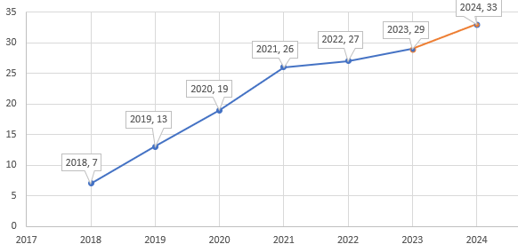
Executive Summary
Since the Supreme Court’s decision in 2018 to overturn ban on sports betting, dozens of states have legalized online and/or in-person betting.
As of today 29, states joined the betting boom increasing monthly revenues 14-fold since the first months of 2018.
Our group decided to share a snapshot of the changing industry.

Slide 3
Focus
Despite legalization, differences in state regulations have a visible effect on the industry’s growth and tax revenues.
Factors with potential impact on industry’s growth:
accessibility to placing bets
taxation of gambling income

Slide 4
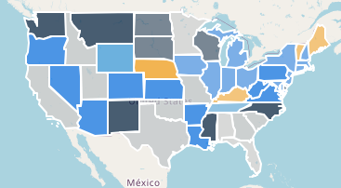
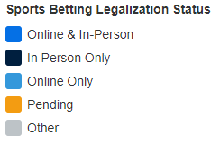
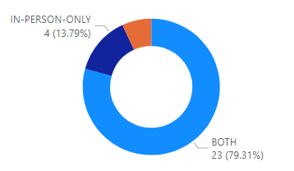
National Data
1
As of June 2023:
23 states legalized both in person and online betting
4 states allow in-person- only betting
2 states allow online-only betting
17 states still consider sport betting illegal
4 states are preparing to vote on legalization

Slide 5
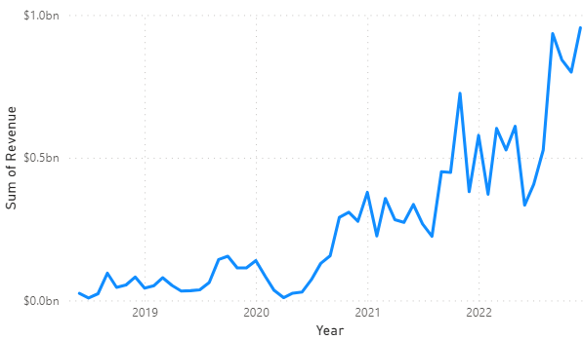
Revenue Growth
1
Since legalization in 2018, the industry’s annual revenues showed significant increase.
While industry suffered during the COVID shutdowndowns, the market rebounded quickly.
Revenues skyrocketed in the third quarter of 2021 supported by bet legalization in 6 more states.
Overall, betting revenues pick up in the third quarter due to the sport event calendar, but the observed increases have been compounded by new states joining the landscape.

Slide 6
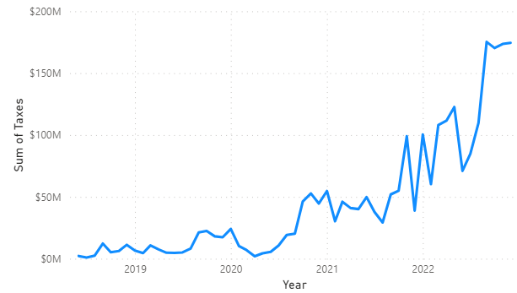
Tax Revenues
While not all states tax income from sports betting, all benefit from growing betting revenues.
83%
Currently 24 out of 29 states tax income from gambling

Slide 7
Revenue per person
Because revenues are largery impacted by population size of each state passing favorable legislation, revenue per person might be a better gauge of sports betting popularity. In population data analysis, we put each states 18+ population against the total revenues.
For the comparison, the average revenue per capita for 2018 could be estimated at $19, while the same average for 2022 was estimated at $123.

Slide 8
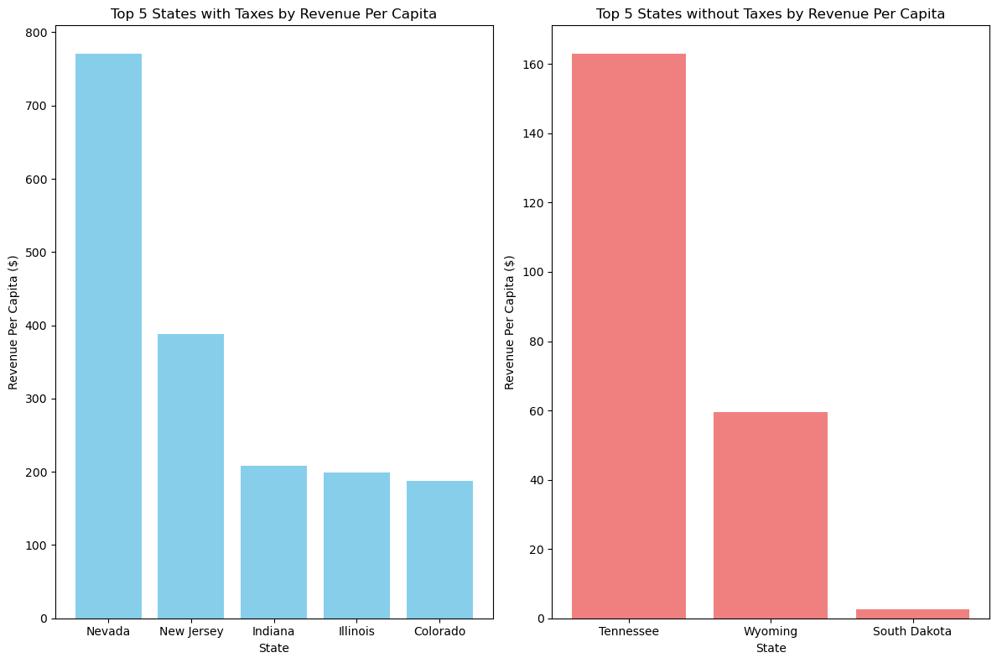
State Data

Slide 9
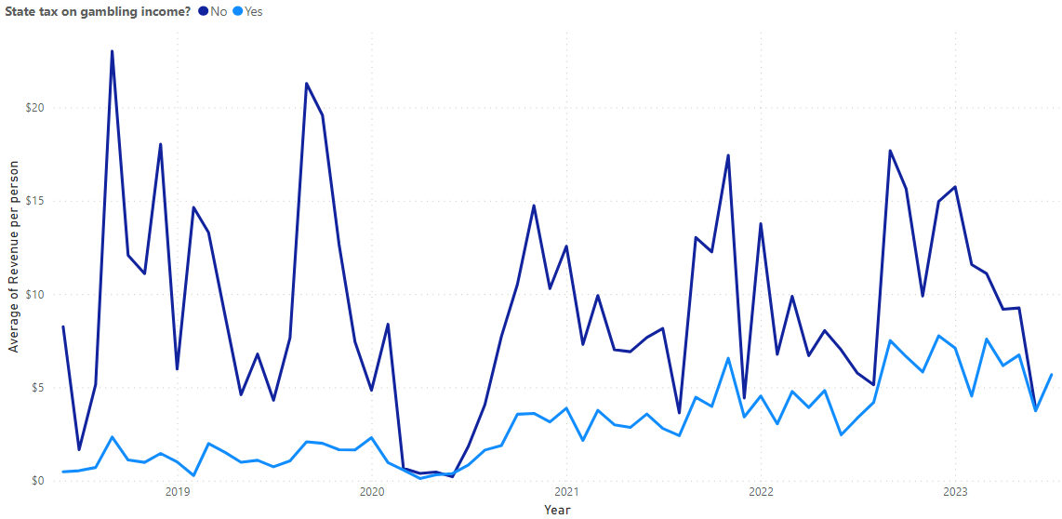
State comparison revs per capita [taxes/no taxes]
Average revenue per person in states taxing income from gambling: $3.41
Average revenue per person in states taxing income from gambling: $6.36

Slide 10
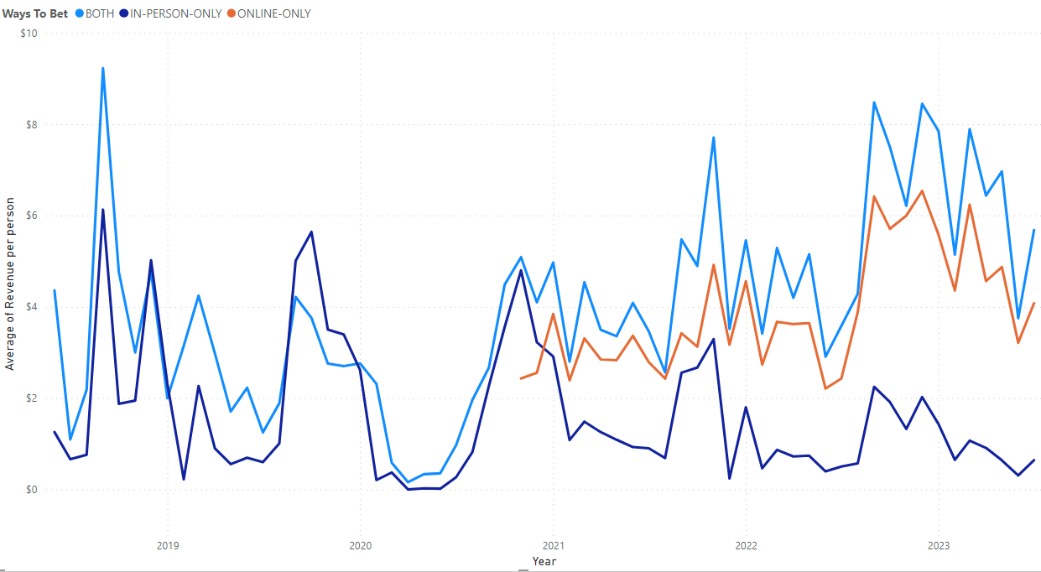
State comparison revs per capita [ways to bet]
Average revenue per person in states allowing betting online and in-person: $4.39
Average revenue per person in states allowing betting online only: $4.05
Average revenue per person in states allowing betting in-person betting only: $1.53

Slide 11
Tools Used
Data Scraping: Beautiful Soup
Visualizations: Leaflet, Plotly, Chart.js JavaScript Libraries
Database: SQL
Prototype: PowerBi

Slide 12





Slide 13
References
Data Scraping:
Sports Betting Revenue Tracker: US Betting Revenue & Handle By State (legalsportsreport.com)
states.csv | Dataset Publishing Language | Google for Developers
US Gambling Win Tax Rates - Are Gambling Wins Taxable? (playusa.com)
States With Legal Sports Betting: Where All 50 States Stand (gamingtoday.com)
APIs
US Census Data

